Slide 1
Segmentation ,Targeting Positioning & Differentiation

Slide 2
What is marketing?
What is need ?
What is want?
What is demand?

Slide 3
Can we make a brand of product which can satisfy need of the entire market ?

Slide 4
Concept of Market Segmentation
Definition
Market segmentation is the process of dividing market into small homogeneous groups with similar characteristics

Slide 5
Criteria for Segmentation
Measurable
Substantial
Accessible
Differentiable
Actionable

Slide 6
Bases for Segmentation
Geographic segmentation:
Nations
Regions
States
Cities

Slide 7
Demographic Segmentation:
Age
Gender
Income
Occupation
Education
Religion
Nationality

Slide 8
Psychographic Segmentation:
Lifestyle
Personality
Value

Slide 9
Behavioral segmentation:
Occasions
Benefits
Usage rate ( Low , Medium, High)
Loyal status
a) Hardcore loyal b) Split loyal c) Shifting loyal d) Switchers
Buyer readiness

Slide 10
Targeting
Here marketer focuses his attention on targeting the selected segment that is relevant to his product and likely to respond positively

Slide 11
Attractiveness of segment
Size of the segment
Growth rate of the segment
Threat of substitute
Bargaining power buyer
Bargaining of supplier
Required market share to get break even
Expected profit margin for that segment

Slide 12
Targeting strategies
Undifferentiated targeting : In this strategy, the whole target market is treated as one and it is considered that there are no market segments that show uncommon needs. The company believes on ‘one product-all segments strategy’
For example, Coca Cola sells Maaza, Mirinda, etc. and does not differentiate between the target audience.

Slide 13
Targeting strategies
Differentiated targeting : In this marketing strategy the company divides the market into segments and uses different product for each segment. This strategy is used by Hindustan Unilever which sells soaps like Lifebuoy, Lux, Rexona, Liril, Pears, Dove etc. and each has its own market.

Slide 14
Targeting strategies
Concentrated targeting : In this marketing strategy the company follows ‘one product one segment policy’. For example SKF Bearings produces bearings all types of automotives.

Slide 15
Differentiation
Process by which companies make consumer perceive their product different from competitors product

Slide 16
Product differentiation
Here companies play with physical attribute of the products and try make it different from competitor’s product

Slide 17
Product differentiation
Product form
Medicine can be in tablet , injection ,syrup form
HUL’s Lux soap is available in cake form as well as liquid form
VIM dish cleaner is available in bar as well as liquid form
Design
Good design takes care of functionality as well as aesthetic value of the product and makes product unique
Sony products are famous for its design
Features
These days firms differentiate their product by adding new features to it
For this company has to pay lot of attention on research & development
TV ( LCD, LED. Full HD, USB drive, etc.)
Mobiles ( Bluetooth, touch screen, Higher memory etc)

Slide 18
Product differentiation
Size of package
Firm can differentiate their product by changing size and weight of the product
Product quality
Product quality has to be very superior which makes product highly differentiated
Quality generates brand loyalty
Durability
If product is durable people don’t mind paying premium for the product.

Slide 19
Service differentiation
Some times it is very difficulty to differentiate product on physical attributes . Computer, industrial goods
Product features are very susceptible to imitation

Slide 20
Service differentiation
Ordering ease
It refers to ease with which customer can place his order
Amazon, flipkart
Delivery
This refers to how well and quickly product is delivered to the customer
Dunzo , Domino pizza
Installation & demo
Installation play very important role in industrial as well as consumer product
DTH connection, and all industrial equipments
Guarantee and warrantee
Guarantee & warrantees can be very differentiator

Slide 21
Service differentiation
Financial assistance
It can be big differentiator
Housing , consumer durable ,vehicle
Maintenance and repair
Companies provide maintenance and repair for their product and services
Disposal
Companies can also differentiate their product on disposal facility
“Purand do naya lo”

Slide 22
Market Positioning
In positioning marketer plays with mind of the customer
Product positioning is process of undertaking all activities which will create image of the product in the minds of the customer in comparison to the competitor’s product

Slide 23
The four major positioning errors that a company must avoid are
Under positioning: Some companies find that buyers have only an unclear idea of the brand.
Over positioning: Buyers have very narrow image of the brand.
Example . Tanishq , Aaua Sure
Confused positioning: Buyers have confused image of the brand
Example : Pepsi once introduced Clear Pepsi
Doubtful positioning: Buyers do not easily believe the claims made by brands about the product’s features, price or manufacturer.
Example: Tele shopping product like slimming tea, hair oil, All New Mobile handset companies like, maxx, karbon, lava,g-five, t-series,i-ball etc.

Slide 24
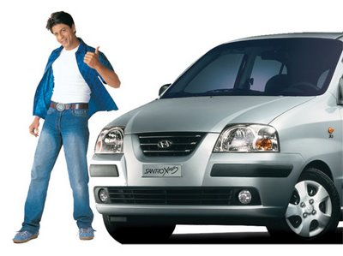
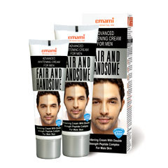


Bases of positioning the product
Attribute positioning: The company positions itself on the basis of attribute like size or number of years in existence. Example :Raymonds “ Fine fabric since 1925”
Benefit positioning: The company positions its product as leader in providing a certain benefit. For example Santro positioned itself as India’s simplest car to drive.
Use or application positioning: The company positions its products as best for certain use or application. For example, Fem Bleach
User positioning: The company positions its product as best for some user group. For example, Fair and handsome cream is specially meant for males

Slide 25



Competitor positioning: The company claims its products as better than a named competitor. ( TV manufacturer compare it with other brand )
Product category positioning: The company positions its product as leader in certain product category. For example, Bajaj CT 100 was positioned as leader in the entry segment bikes.
Price & quality positioning: The product is positioned as offering the best value. For example, Big bazzar “Is se sasta aur Achcha kahee nahee milenga”

